Slide 1
Government College, Ropar
Dept. of English
Speech : I Have A Dream
By : Martin Luther King Jr.’
Presented by :Prof. Dinesh Kumari

Slide 2
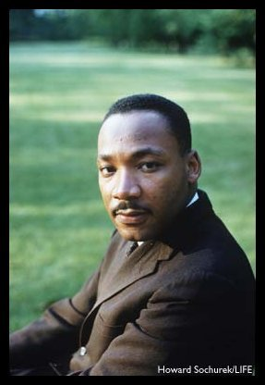
Martin Luther King, Jr.
1929-1968

Slide 3

King spoke to 250,000 civil rights supporters during the “March on Washington” August 28, 1963. King made his famous “I have a dream” speech.

Slide 4
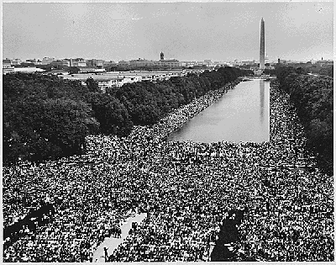
I HAVE A DREAM
August 28, 1963

Slide 5
Section 1
Emancipation Proclamation
Abraham Lincoln signed the Emancipation Proclamation, which promised freedom to Negroes. One hundred years later, Negroes are still not free because they are faced by harsh discrimination and segregation.

Slide 6
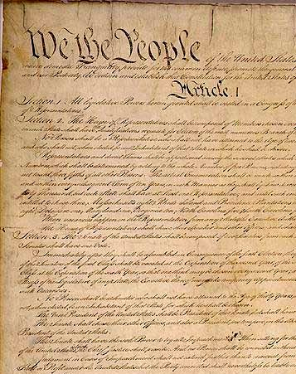
Section 2
Unalienable Rights
The Constitution and the Declaration of Independence guaranteed all men the unalienable rights to life, liberty, and the pursuit of happiness. America has not kept their promise and have given Negroes a bad check, but the back of justice is not bankrupt.

Slide 7
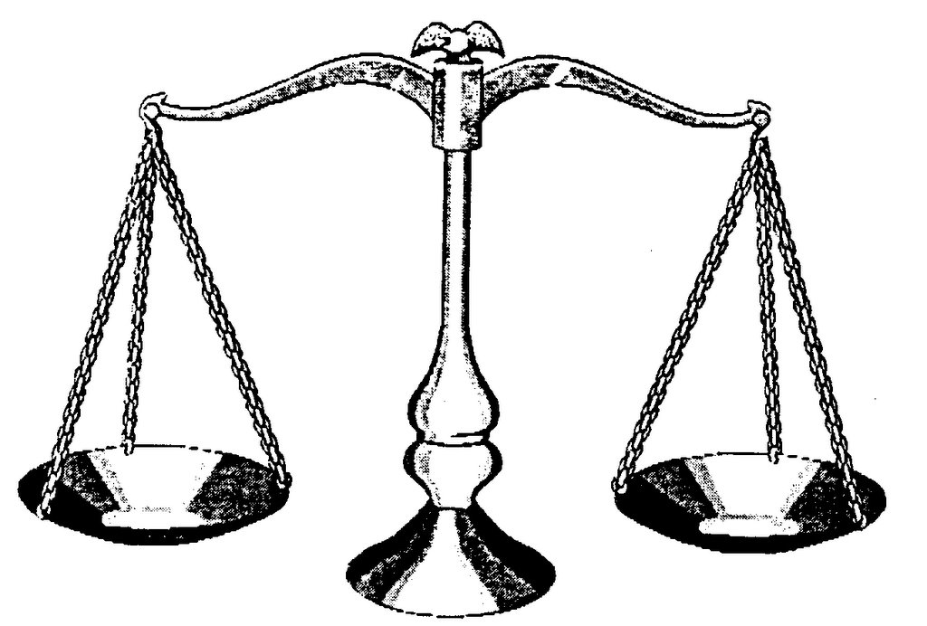
Section 3
Racial Justice
Now is the time to rise out of segregation and work towards racial justice. Now is the time to give opportunities to all God’s children to the solid rock of brotherhood.

Slide 8
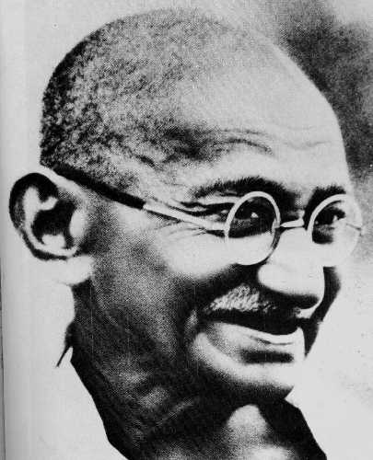
Section 4
No Violence
African Americans must gain our rightful place through nonviolence and rise above physical force and instead use soul force to accomplish our goals.

Slide 9
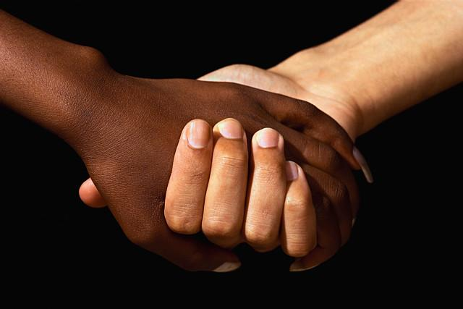
Section 5
Work with Whites
African Americans have to work with whites, not against them in order to work towards freedom. Our destiny is tied up, we cannot walk alone.

Slide 10
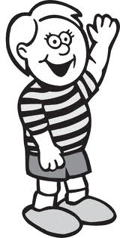
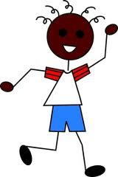
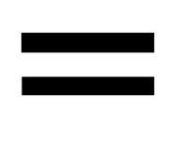
Section 6
No Settling for Equality
African Americans will not be satisfied with anything until we reach total equality and freedom, including the right to vote.

Slide 11
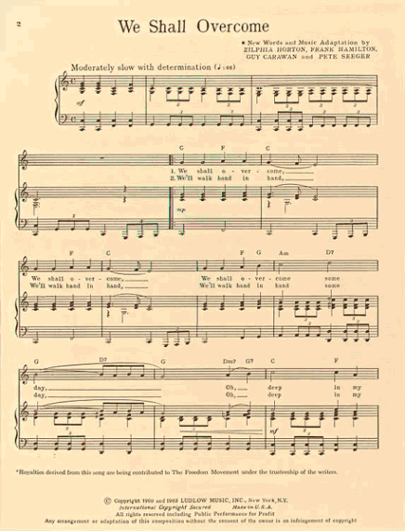
Section 7
Unite in Brotherhood
One day, all men will be created equal. Former slaves will unite with slave owners in brotherhood, people will be judged by their character rather that their race, and children of different colors will join hands with one another.

Slide 12
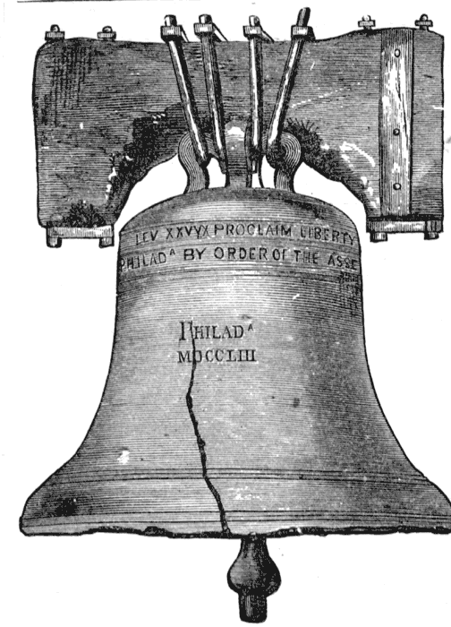
Section 8
Let Freedom Ring
For America to be a great place, we all need to be equal. Let freedom ring!

Slide 13
Thank you

